Slide 1
CS276A
Text Retrieval and Mining
Lecture 15
Thanks to Thomas Hoffman, Brown University
for sharing many of these slides.

Slide 2
Recap: Clustering 2
Hierarchical clustering
  Agglomerative clustering techniques
Evaluation
Term vs. document space clustering
Multi-lingual docs
Feature selection
Labeling

Slide 3
Linear Algebra Background

Slide 4

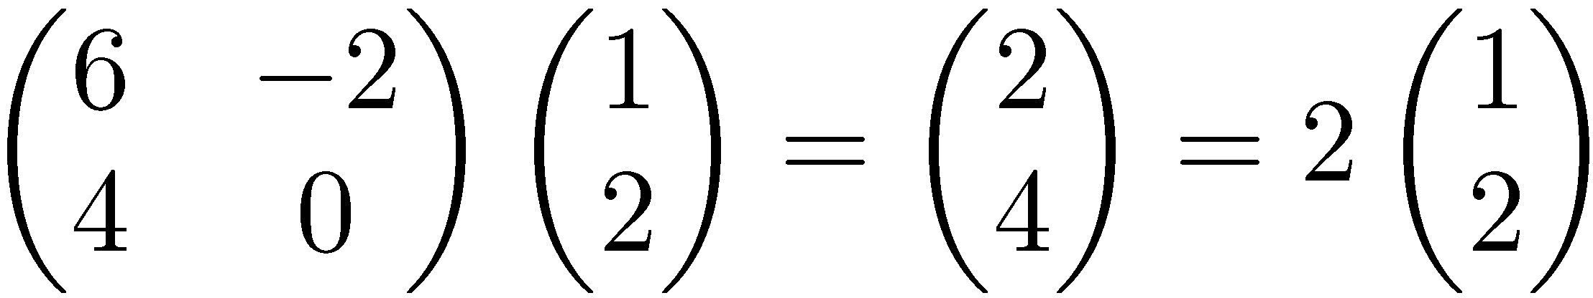
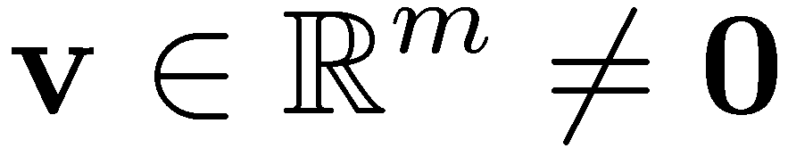

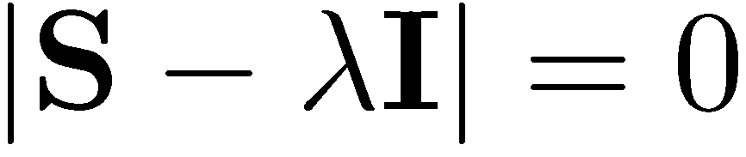
Eigenvalues & Eigenvectors
Eigenvectors (for a square m×m matrix S)
How many eigenvalues are there at most?
Example
(right) eigenvector
eigenvalue
only has a non-zero solution if
this is a m-th order equation in λ which can have at most m distinct solutions (roots of the characteristic polynomial) – can be complex even though S is real.

Slide 5
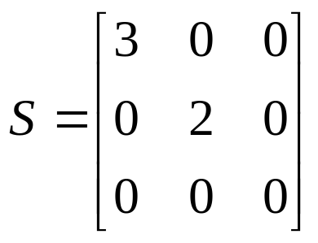
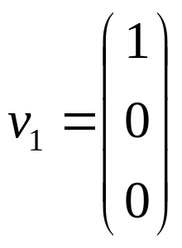
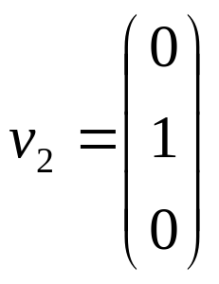
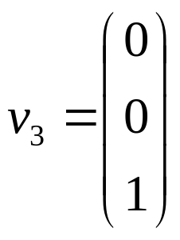

Matrix-vector multiplication
has eigenvalues 3, 2, 0 with
corresponding eigenvectors
On each eigenvector, S acts as a multiple of the identity
matrix: but as a different multiple on each.
Any vector (say x= ) can be viewed as a combination of
the eigenvectors: x = 2v₁ + 4v₂ + 6v₃

Slide 6
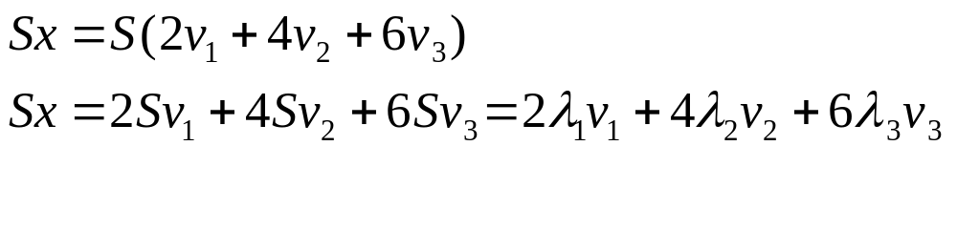
Matrix vector multiplication
Thus a matrix-vector multiplication such as Sx (S, x as in the previous slide) can be rewritten in terms of the eigenvalues/vectors:
Even though x is an arbitrary vector, the action of S on x is determined by the eigenvalues/vectors.
Suggestion: the effect of “small” eigenvalues is small.

Slide 7
Eigenvalues & Eigenvectors
For symmetric matrices, eigenvectors for distinct
eigenvalues are orthogonal
  All eigenvalues of a real symmetric matrix are real.
All eigenvalues of a positive semidefinite matrix
are non-negative

Slide 8
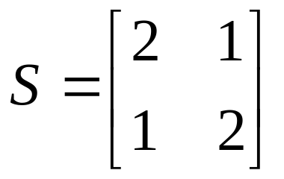
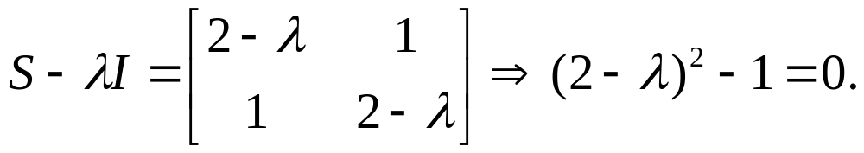
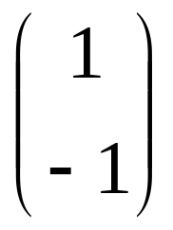
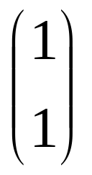
Example
Let
Then
The eigenvalues are 1 and 3 (nonnegative, real).
The eigenvectors are orthogonal (and real):
Real, symmetric.
Plug in these values and solve for eigenvectors.

Slide 9
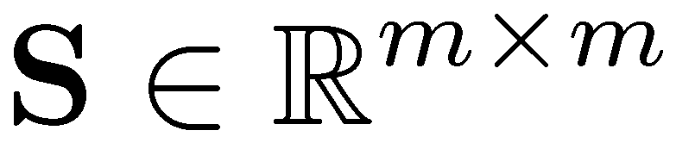
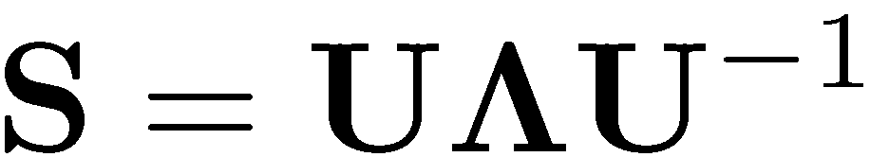


Eigen/diagonal Decomposition
Let be a square matrix with m linearly independent eigenvectors (a “non-defective” matrix)
Theorem: Exists an eigen decomposition
  (cf. matrix diagonalization theorem)
Columns of U are eigenvectors of S
Diagonal elements of are eigenvalues of
Unique for distinct eigen-values
diagonal

Slide 10
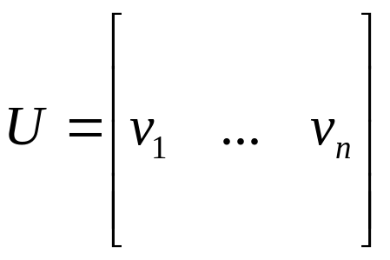
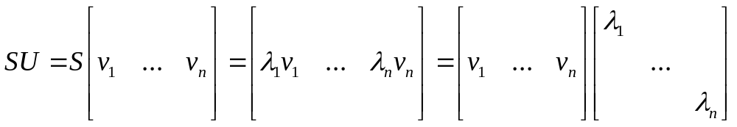
Diagonal decomposition: why/how
Let U have the eigenvectors as columns:
Then, SU can be written
Thus SU=UΛ, or U^{–1}SU=Λ
And S=UΛU^{–1}.

Slide 11
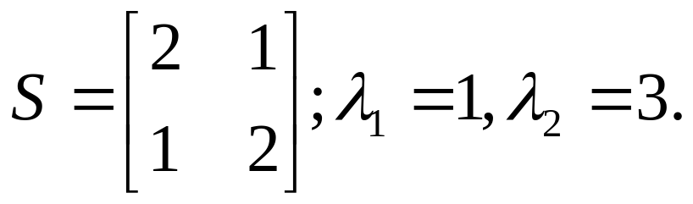
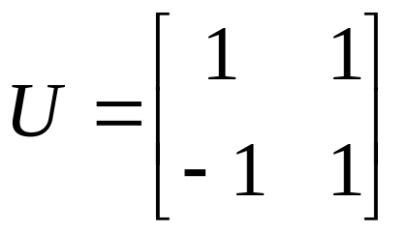
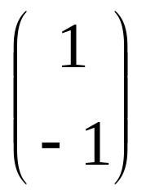
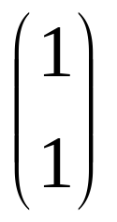
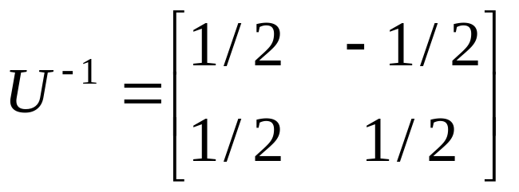
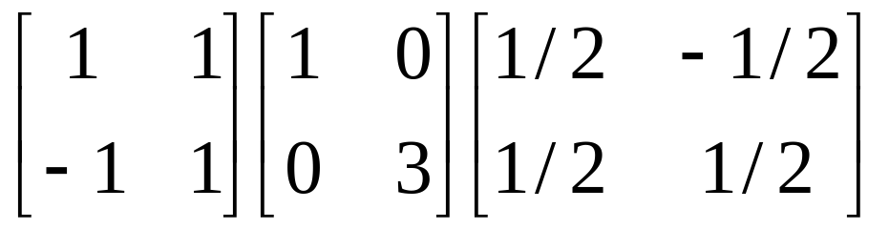
Diagonal decomposition - example
Recall
The eigenvectors and form
Recall
UU^{–1} =1.
Inverting, we have
Then, S=UΛU^{–1} =

Slide 12

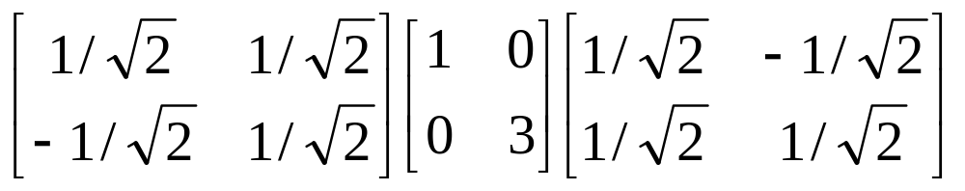
Example continued
Let’s divide U (and multiply U^{–1}) by
Then, S=
Q
Λ
(Q⁻¹= Q^{T} )
Why? Stay tuned …

Slide 13
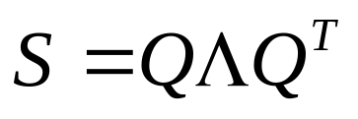
Symmetric Eigen Decomposition
If is a symmetric matrix:
Theorem: Exists a (unique) eigen decomposition
where Q is orthogonal:
  Q⁻¹= Q^{T}
  Columns of Q are normalized eigenvectors
  Columns are orthogonal.
  (everything is real)

Slide 14
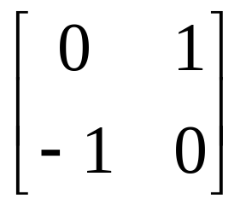
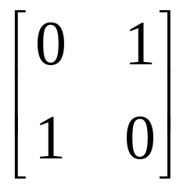
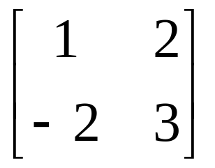
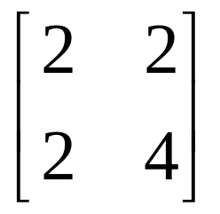
Exercise
Examine the symmetric eigen decomposition, if any, for each of the following matrices:

Slide 15
Time out!
I came to this class to learn about text retrieval and mining, not have my linear algebra past dredged up again …
  But if you want to dredge, Strang’s Applied Mathematics is a good place to start.
What do these matrices have to do with text?
Recall m× n term-document matrices …
But everything so far needs square matrices – so …

Slide 16
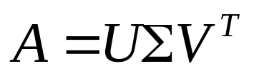
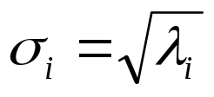
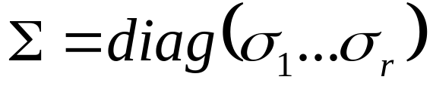
Singular Value Decomposition
For an m× n matrix A of rank r there exists a factorization
(Singular Value Decomposition = SVD) as follows:
m×m
m×n
V is n×n
The columns of U are orthogonal eigenvectors of AA^{T}.
The columns of V are orthogonal eigenvectors of A^{T}A.
Eigenvalues λ₁ … λ_{r} of AA^{T} are the eigenvalues of A^{T}A.
Singular values.

Slide 17
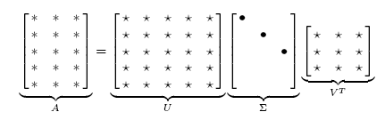
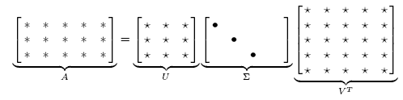
Singular Value Decomposition
Illustration of SVD dimensions and sparseness

Slide 18
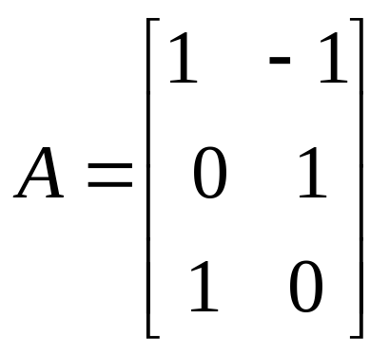
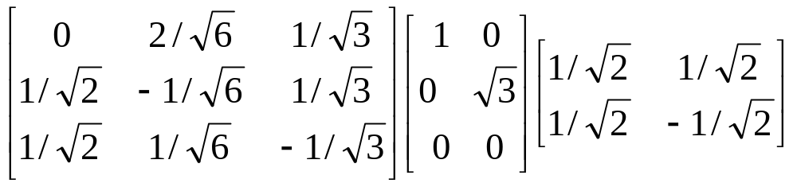
SVD example
Let
Thus m=3, n=2. Its SVD is
Typically, the singular values arranged in decreasing order.

Slide 19
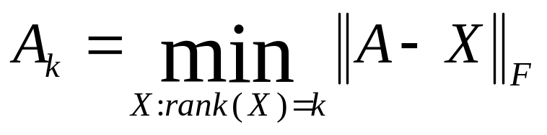

Low-rank Approximation
SVD can be used to compute optimal low-rank approximations.
Approximation problem: Find A_{k} of rank k such that
A_{k} and X are both m×n matrices.
Typically, want k << r.
Frobenius norm

Slide 20
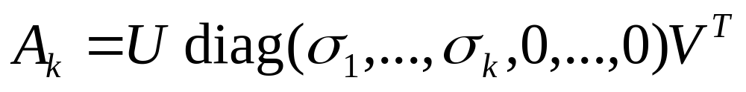
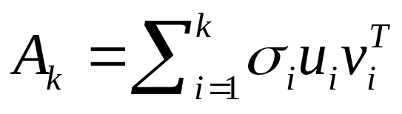
Low-rank Approximation
Solution via SVD
set smallest r-k
singular values to zero
k
column notation: sum
of rank 1 matrices

Slide 21
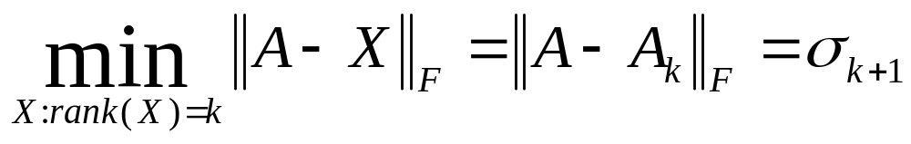
Approximation error
How good (bad) is this approximation?
It’s the best possible, measured by the Frobenius norm of the error:
where the σ_{i} are ordered such that σ_{i} ≥ σ_{i+1}.
Suggests why Frobenius error drops as k increased.

Slide 22
Recall random projection
Completely different method for low-rank approximation
Was data-oblivious
  SVD-based approximation is data-dependent
Error for random projection depended only on start/finish dimensionality
  For every distance
Error for SVD-based approximation is for the Frobenius norm, not for individual distances

Slide 23
SVD Low-rank approximation
Whereas the term-doc matrix A may have m=50000, n=10 million (and rank close to 50000)
We can construct an approximation A₁₀₀ with rank 100.
  Of all rank 100 matrices, it would have the lowest Frobenius error.
Great … but why would we??
Answer: Latent Semantic Indexing
C. Eckart, G. Young, The approximation of a matrix by another of lower rank. Psychometrika, 1, 211-218, 1936.

Slide 24
Latent Semantic Analysis via SVD

Slide 25
What it is
From term-doc matrix A, we compute the approximation A_{k.}
There is a row for each term and a column for each doc in A_{k}
Thus docs live in a space of k<<r dimensions
  These dimensions are not the original axes
But why?

Slide 26
Vector Space Model: Pros
Automatic selection of index terms
Partial matching of queries and documents (dealing with the case where no document contains all search terms)
Ranking according to similarity score (dealing with large result sets)
Term weighting schemes (improves retrieval performance)
Various extensions
  Document clustering
  Relevance feedback (modifying query vector)
Geometric foundation

Slide 27
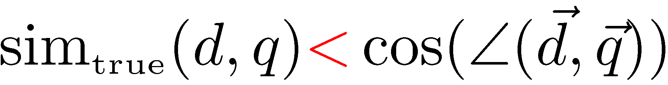
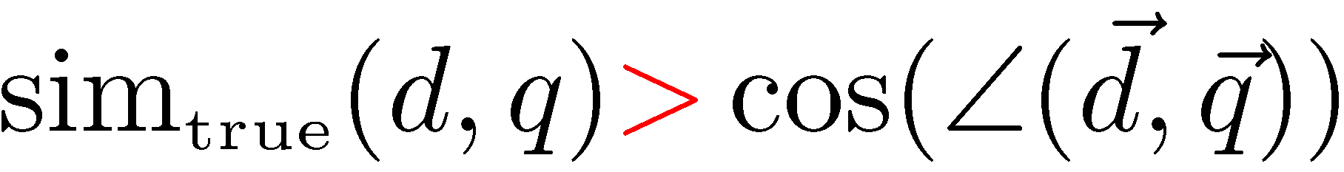
Problems with Lexical Semantics
Ambiguity and association in natural language
  Polysemy: Words often have a multitude of meanings and different types of usage (more urgent for very heterogeneous collections).
  The vector space model is unable to discriminate between different meanings of the same word.
  Synonymy: Different terms may have an identical or a similar meaning (weaker: words indicating the same topic).
  No associations between words are made in the vector space representation.

Slide 28
Polysemy and Context
Document similarity on single word level: polysemy and context
ring
jupiter
•••
space
voyager
meaning 1
…
planet
...
…
saturn
...
meaning 2
car
company
•••
dodge
ford
contribution to similarity, if used in 1st meaning, but not if in 2nd

Slide 29
Latent Semantic Analysis
Perform a low-rank approximation of document-term matrix (typical rank 100-300)
General idea
  Map documents (and terms) to a low-dimensional representation.
  Design a mapping such that the low-dimensional space reflects semantic associations (latent semantic space).
  Compute document similarity based on the inner product in this latent semantic space
Goals
  Similar terms map to similar location in low dimensional space
  Noise reduction by dimension reduction

Slide 30
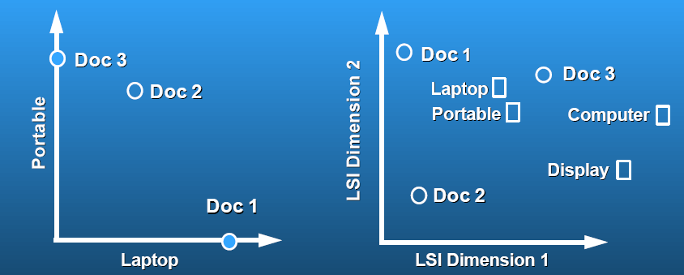
Latent Semantic Analysis
Latent semantic space: illustrating example
courtesy of Susan Dumais

Slide 31
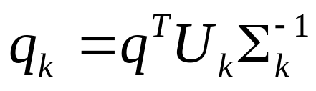
Performing the maps
Each row and column of A gets mapped into the k-dimensional LSI space, by the SVD.
Claim – this is not only the mapping with the best (Frobenius error) approximation to A, but in fact improves retrieval.
A query q is also mapped into this space, by
  Query NOT a sparse vector.

Slide 32
Empirical evidence
Experiments on TREC 1/2/3 – Dumais
Lanczos SVD code (available on netlib) due to Berry used in these expts
  Running times of ~ one day on tens of thousands of docs
Dimensions – various values 250-350 reported
  (Under 200 reported unsatisfactory)
Generally expect recall to improve – what about precision?

Slide 33
Empirical evidence
Precision at or above median TREC precision
  Top scorer on almost 20% of TREC topics
Slightly better on average than straight vector spaces
Effect of dimensionality:
Dimensions | Precision
250 | 0.367
300 | 0.371
346 | 0.374

Slide 34
Failure modes
Negated phrases
  TREC topics sometimes negate certain query/terms phrases – automatic conversion of topics to
Boolean queries
  As usual, freetext/vector space syntax of LSI queries precludes (say) “Find any doc having to do with the following 5 companies”
See Dumais for more.

Slide 35
But why is this clustering?
We’ve talked about docs, queries, retrieval and precision here.
What does this have to do with clustering?
Intuition: Dimension reduction through LSI brings together “related” axes in the vector space.

Slide 36
Intuition from block matrices
n documents
Block 1
What’s the rank of this matrix?
Block 2
0’s
m
terms
…
0’s
Block k
= non-zero entries.

Slide 37
Intuition from block matrices
n documents
Block 1
Block 2
0’s
m
terms
…
0’s
Block k
Vocabulary partitioned into k topics (clusters); each doc discusses only one topic.

Slide 38
Intuition from block matrices
n documents
Block 1
What’s the best rank-k
approximation to this matrix?
Block 2
0’s
m
terms
…
0’s
Block k
= non-zero entries.

Slide 39
Intuition from block matrices
Likely there’s a good rank-k
approximation to this matrix.
wiper
Block 1
tire
V6
Block 2
Few nonzero entries
…
Few nonzero entries
Block k
car
1
0
automobile
0
1

Slide 40
Simplistic picture
Topic 1
Topic 2
Topic 3

Slide 41
Some wild extrapolation
The “dimensionality” of a corpus is the number of distinct topics represented in it.
More mathematical wild extrapolation:
  if A has a rank k approximation of low Frobenius error, then there are no more than k distinct topics in the corpus.

Slide 42
LSI has many other applications
In many settings in pattern recognition and retrieval, we have a feature-object matrix.
  For text, the terms are features and the docs are objects.
  Could be opinions and users … more in 276B.
This matrix may be redundant in dimensionality.
  Can work with low-rank approximation.
  If entries are missing (e.g., users’ opinions), can recover if dimensionality is low.
Powerful general analytical technique
  Close, principled analog to clustering methods.

Slide 43
Resources
http://www.cs.utk.edu/~berry/lsi++/
http://lsi.argreenhouse.com/lsi/LSIpapers.html
Dumais (1993) LSI meets TREC: A status report.
Dumais (1994) Latent Semantic Indexing (LSI) and TREC-2.
Dumais (1995) Using LSI for information filtering: TREC-3 experiments.
M. Berry, S. Dumais and G. O'Brien. Using linear algebra for intelligent information retrieval. SIAM Review, 37(4):573--595, 1995.

